Slide 1

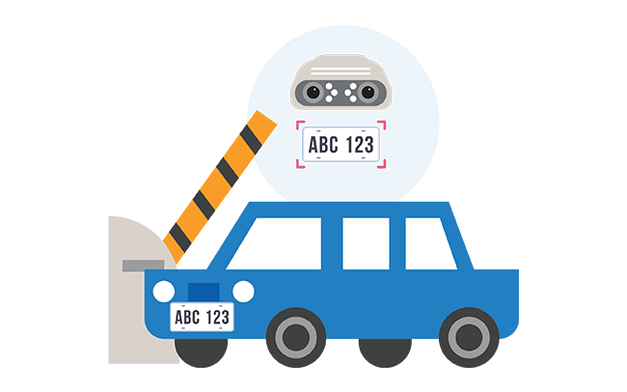
CAR NUMBER PLATE DETECTION SYSTEM

Slide 2

Under the guidance (mentor) of Aishwarya Saxena
By - Sumanth Kumar S
Machine Learning - Python
College - Sahyadri College of Engineering
and Management Mangalore
Summer Internship – June-July 2020

Slide 3


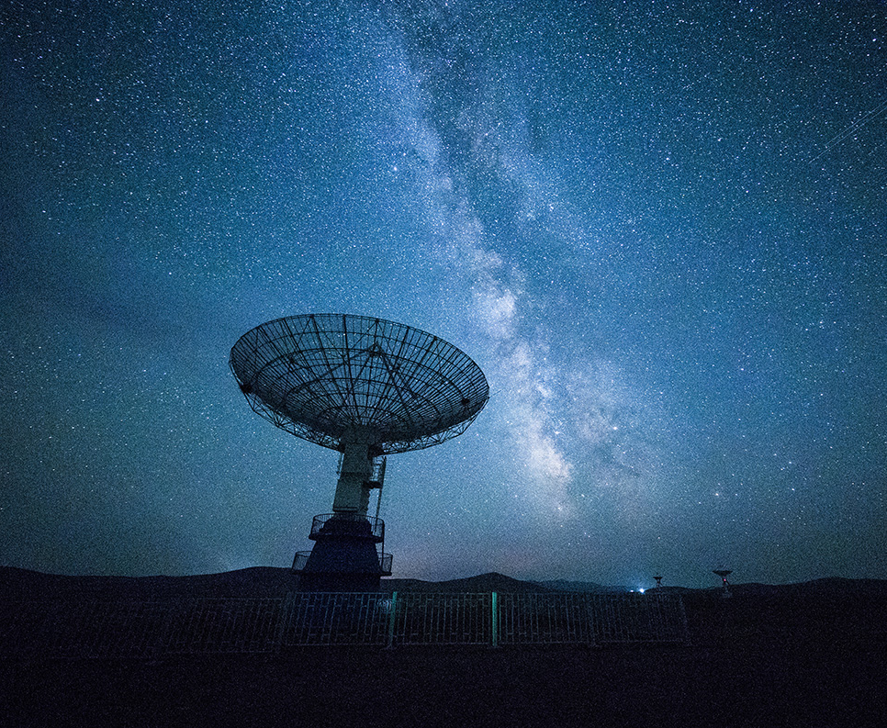
contents
Introduction
Background
Hardware and software requirements
Future scope
Objective
Conclusion
REFERENCES AND BIBLIOGRAPHY

Slide 4
Introduction
Car Number Plate Detection was simply the ability to automatically extract and recognition a vehicle number plate’s characters from an image. In essence it consists of a camera grabbing image of a plate and analyse the character and number of plate and store the data or the information as a record. The extracted characters are used in recognition tool to translate the pixels into numerical readable character.
It can also help in using speed enforcement and tool collection to management of parking. It can also be used to detect and prevent a wide range of criminal activities and security control of highly restricted areas. These can be used to in traffic controls by calculating the numerous vehicles.

Slide 5
objective
In the tollgate numerous cars are passing by daily. Due to this keeping the record of each Car Number plate.
Due to which human stress is reduced.
Analysing each and every number plate is fastly and efficiently.
Time taken by automated entry is less than manual entry
Overall due to automated entry cost of analysing each entry has be reduced

Slide 6
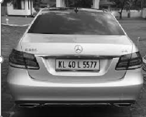
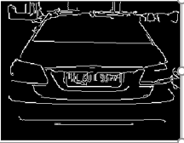
BACKGROUND:
Taking the image of car and using the python code to analyse the structure of car and coping the image in another slot Gray (gray = cv2.cvtColor(image, cv2.COLOR_BGR2GRAY))
Taking another image changing its edges blurring the Gray scale of image (edges = cv2.Canny(blur, 30, 200)) so that it highlights the number plate.

Slide 7
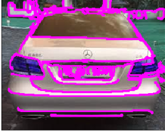

Reduce the intensity and contours (_ = cv2.drawContours(image_copy,cnts,-1,(255,0,255),2)) of the image by checking the structure of number plate if it’s a rectangle (x, y, w, h = cv2.boundingRect(c))
Final number plate obtained by structure analysis and storing the number plate image in the file ( cv2.imwrite("plate.png", plate)). After storing the image by using pytesseract (text = pt.image_to_string(plate, lang='eng')) decoding the image to give actual character in number plate ‘KL 40 L 5577’.

Slide 8
Hardware and software requirements
HARDWARE REQUIREMENTS:
Hardware Tools | Minimum Requirements
Processor | i3 or greater version
Hard Disk | 10GB
RAM | 8GB
Monitor | Intel HD
Keyboard | 112
Mouse | Optical

Slide 9
SOFTWARE REQUIREMENTS:
Software Tools | Minimum Requirements
Platform | Windows, Linux, MacOS
Operating system | Windows, Linux, MacOS
Technology | Machine Learning in Python
Scripting Language | Python
IDE | Pycharm, Jupyter

Slide 10
FUTURE SCOPE:
The CNPD (Car Number Plate Detection) can exploited for owner identification, vehicle model identification traffic control, vehicle speed control and vehicle location tracking.
Most of the time the car number plate detector focus on one number plate but in real-time there can be more than one vehicle number plate image gets captured in the CNPD.
It takes time to analyse the multiple number plate.
Traffic control and vehicle owner identification has become major problem in every country sometimes it is difficult to identify vehicle owner when they violates the traffic rules.
By number plate recognition software is used to analyse the number plate and identify the owner of the car by get information of the number plate.

Slide 11
CONCLUSION:
In order to improve the speed and accuracy of license plate image detection and recognition in complex environments.
Relevant algorithms need to be studied and improved for one or more factors, which is of great significance for the improvement .
Optimization of license plate detection and recognition technology.

Slide 12
REFERENCES AND BIBLIOGRAPHY:
Datasets (https://www.kaggle.com/)
Sklearn Libraries (https://scikit-learn.org/stable/)
Automatic License Plate Recognition (IEEE T INTELL TRANSPORT)
Algorithm References (https://ieeexplore.ieee.org/document/)
"Forensic person tracking method and apparatus".

Slide 13


Thank You!

